Slide 1
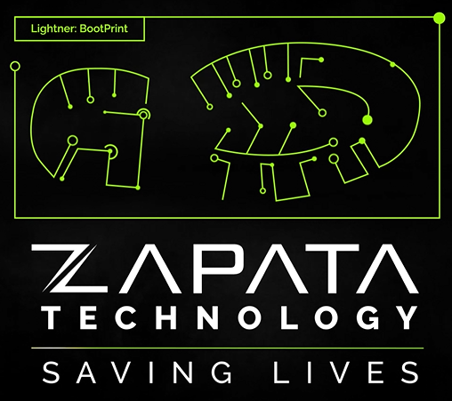
North American Industry Classification System (NAICS):
541511 541512 541513 541519
Capabilities Overview 2023

Slide 2
What We Do and Our Mission
U.S. government agencies rely on Zapata Technology. We assure that our men and women in uniform have the most advanced technology and interoperability to support their missions. Wherever we are needed around the world, we develop the solution, create the design, and manage those critical systems and intelligence operations.
We save lives by deploying well-resourced experts wherever they are needed to achieve results. When called upon, Zapata Technology’s people are America’s Tech Defenders directly supporting and protecting our Nation and its interests.

Slide 3
Overview
8(a) - SBA Certified
Top Secret Facility Clearance (SCI)
Veteran Owned and SBA VOSB
International Traffic in Arms Regulations (ITAR) Compliant
NIST 800-171 Compliant
ISO 9001; 2015 Audited
Small Disadvantaged Business
Cage Code: 4VC65
DUNS Number: 80-696-1376
UEI: DBXFMY56RK33
AWARDS
Two-time winner
Founded in 2007

Slide 4
Technologies

Slide 5
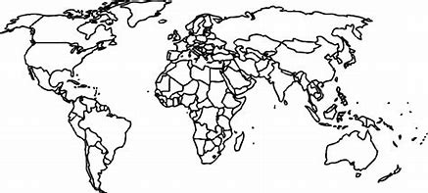
Recent Work Locations (CONUS / OCONUS)
CONUS
Fort Bragg, NC
Fort Gordon, GA
Fort Hood, TX
Fort Huachuca, AZ
Fort Shafter, HI
Northern VA
The Pentagon
Camp Pendleton
OCONUS
Afghanistan
Germany
Korea
Japan

Slide 6
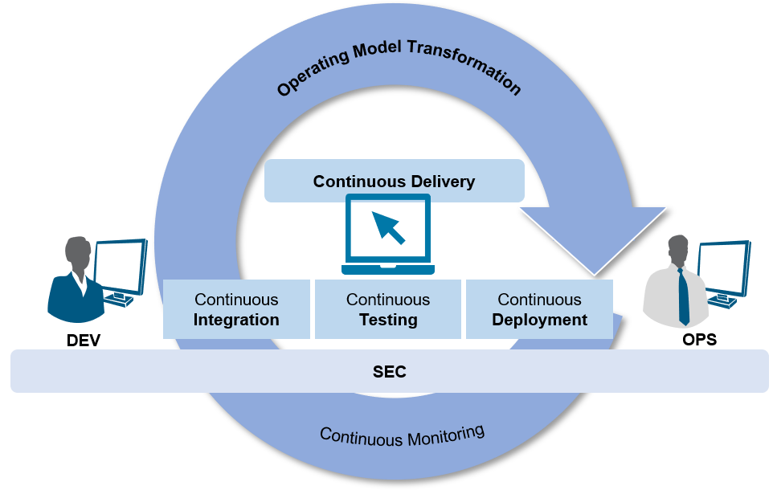
Core Competencies
Systems Architecture and Engineering
Software Development Lifecycle (SDLC)
Cybersecurity – Information Assurance
Data Management and Engineering
Software Application Development
Lab Managemeng and Interoperability
DevSecOps

Slide 7
Capabilities - ZIngest
ZIngest – Data Ingestion Tool
​
ZIngest is a highly customizable and scalable automated Extract, Transform, Load (ETL) tool for data ingestion, mining and extraction. It provides better management, improved scalability and reliability in relation to its alternative tool such as FeedPipes and JPipeline.
ZIngest greatly simplifies data ingestion and replication and considerably reduces the time required to configure, change and maintain data sources. This software is integratable with third-party software, such as Natural Language Processing(NLP) and big data technologies. ZIngest has a full GUI for building, managing and monitoring data flow.
ZIngest is bundled with a dozen data flow templates for ingestion, replication, and mitigation for the US Army’s DCGS-A program. ZIngest has several components for text extraction and CAPCO classification extraction from images and binary documents. ZIngest brings data engineers, intel analysts, mission managers together in obtaining, analyzing and disseminating intelligence.

Slide 8
Capabilities - ZMonitor
​ZMonitor is a web-based, highly scalable and customizable tool designed to perform near real-time monitoring. ZMonitoring monitors the status of ingestion, replication, system resources/services, and visualization of progression. It allows for multi-server remote monitoring.
ZMonitor supports FeedPipes, JPipeline, data trend, export queues, directories and system resources/services. Support for system resources/services takes advantage of Linux/Windows shell commands and scripts to allow for robust custom monitoring. ZMonitor can monitor Apache Nifi, data trend, software services, file systems, system resources and services, databases record count and SSL keystores.
ZMonitor’s various system functions, data, and resources are accounted for and organized as monitored items with their monitoring type. A monitored item is either a feed schema, an export queue, a directory, a trust certificate or a software service. It is periodically checked against the expected conditions configured for its monitoring type and reported in either one of the four color coded statuses: green (OK), yellow (Warning), red (Critical), and gray (Static/None). This color coding allows the user to quickly respond to the data being monitored, thus minimizing potential issues.

Slide 9
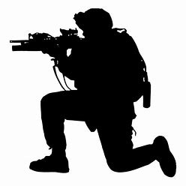
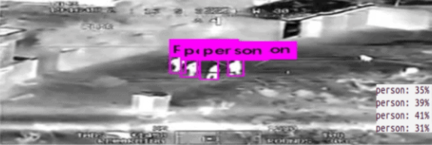
Products - Lightner
Lightner is an Open-Source tool capable of object recognition. This software rapidly identifies objects on labeled datasets supplied by the user.
Lightner applies a single neural network to a full motion video image. The software divides the image into regions and predicts bounding boxes and probabilities for each region. Each bounding box is weighted by the predicted probability. To ensure informed probability, Lightner examines the whole image, in testing, for global context.
Lightner analytical data is provided by frame, in order to observe the code. This allows the user the ability to act when needed without video. The images can be routed to entity extraction or facial recognition.
Lightner is compatible with existing ISR video systems and sensors. It can be used on a low power unattended system (e.g.IOT) and be deployed for on-sensor processing.
This product is available as a bolt on microservice capable of processing multiple video streams simultaneously. Users can directly ingest JavaScript Object Notation (JSON) format for storing and transporting data from each feed or run analytics using data stored in a graph database.

Slide 10
Products - Cascade
CASCADE is a program that matches sentences and paragraphs of a report to specific requirement(s) in addition to matching new requirements against existing reports. This software is an AI/ML framework which also allows for direct input from the user. Using Augmented Intelligence Cascade ensures that the end user is part of the process.
Cascade is built using containers. Containers are lightweight standard unit of software that have all the dependencies and up code to run the application securely, quickly, and reliably from any computing environment. Using containers allows for Cascade code to be reused and rapidly customizable for future add-ons and/or enhancements.
The software uses artificial neural-intelligence for accuracy and speed of report writing. This software has the ability to work on unstructured, semi-structured, and structured data. Cascade identifies, collects and delivers mission critical information more quickly allowing the user to report out to managers/analysts all the relevant information.

Slide 11
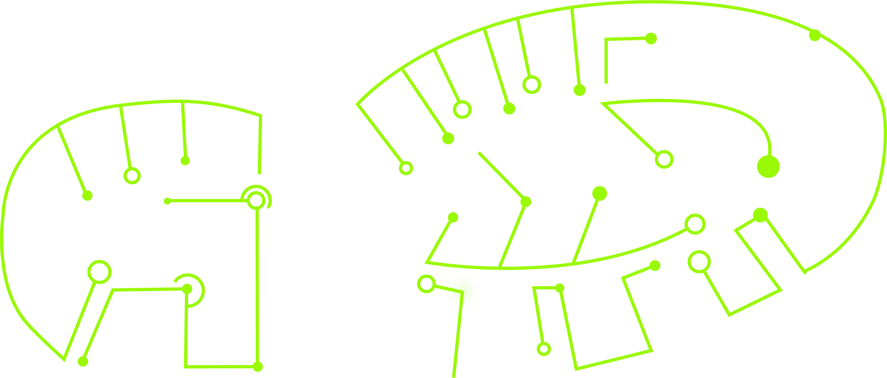
Customer Base
Army
Air Force
Navy
Marines
DIA
NSA
Combatant Commands
(CONUS, OCONUS)
National Intelligence
Community
Department of Defense
(DoD)
11

Slide 12
Project Development
Assess Implementation
Prepare for Next Phase
Baseline Present State
Identify Targets and Milestones
Implement Plan of Action
Develop Vision of the Future

Slide 13
Projects
Army Intelligence Digital Transformation Engineering Services (AIDTES) Zapata supports I2WD’s systems and systems-of-systems with baseline improvements, modernization efforts, and technology insertion of complex architectures operating across multiple branches and operational theatres supporting National, Joint, and Tactical level intelligence operations and domains. These efforts include the installation, integration, and verification of DCGS-A Fusion Brain (DFB), Fixed Infrastructure (DFI), and Fixed Storage (DFS) in addition to software engineering services on pre- and post-deployment initiatives.
Sub-contractor to Booz Allen Hamilton, Inc. Contract Number: GS00Q14OADU308 / S901801BAH Contract Expiration: September 2023
Army Cyber Enterprise Services (ACES) In support of the Army CIO/G6 Cyber Security Directorate, the Zapata Technology CIAV Team serves as the Army’s strategic asset that executes and supports the execution of Coalition Interoperability Assurance and Validation assessments within CIAV’s federated environments to enable Combatant Commands’ (CCMD) operations within both current environments, such as the AMN, within the Mission Partner Environment (MPE), NATO Federated Mission Networking (FMN) and the Joint Information Environment (JIE) constructs.
Sub-contractor to Booz Allen Hamilton, Inc. Contract Number: W52P1J-16-C-0074 / 108412SB3U Contract Expiration: January 2022

Slide 14
Projects
GSA Multiple Award Schedule (MAS) Information Technology (IT)
As a prime schedule holder on the GSA IT MAS, Zapata uses SIN 541-51S to provide IT Professional Services for Database Planning and Design, Systems Analysis, Integration and Design, Programming, Conversion and Implementation Support, Network Services, Data / Records Management, and Testing. These services can be purchased by federal agencies (civilian and military), state and local governments, tribal organizations, and other non-federal entities to focus on missions, utilize limited budgets, streamline transactions, lower costs, maintain control and minimize risks.
Prime
Contract Number: 47QTCA21D0002 Contract Expiration: September 2025
MCTSSA Network, Engineering, Testing and Cybersecurity (NETC)
As a prime contractor on the MCTSSA NETC IDIQ, Zapata will support MCTSSA and MARCORSYSCOM Portfolio Managers with Engineering, Testing, Laboratory management, Configuration management, and other specialized services to include Advanced Network Engineering, Data Science, Artificial Intelligence (AI), Machine Learning (ML), Command, Control, Communication, Computer, and Intelligence (C4I) System Services, and Cybersecurity. Our support will help MCTSSA Program Managers in the conduct of developmental testing, integration, and sustainment support of (C4I) Programs of Record (PoRs) which form the foundation of the Marine Corps net focused operations and are vital to the Marine Corps’ continued success.
Prime Contract Number: M68909-20-D-7604 Contract Expiration: November 2024

Slide 15
Projects
Technical Information Engineering Services (TIES)
In support of the ARSOF Data Integration Initiative (ADI2) project Zapata to the United States Army Special Operations Command (USASOC) G2, Zapata provides USASOC DCGS-A with Data Ingestion and Analytic Processing Development, Systems Engineering Support, and Software Integration and Development Support using Apache NiFi (OSS) and the Zapata-developed ZIngest (GOTS) software. Additionally, for United States Army Intelligence and Security Command (INSCOM) G-37, Zapata provides data ingestion and system enhancement support to assist with the integration of national‐to‐tactical intelligence with multi‐domain operations while operating in complex environments against determined and adaptive enemy organizations.
Sub-contractor to Leidos Contract Number: W56KGU-15-D-0008
US National Data Center Operations Support and Studies II (US NDC OSS II)
In support of the US National Data Center Operations Support and Studies II (US NDC OSS II), Zapata Technology provides enhancements to geophysical analysis capabilities and the operations support aspects of the US NDC mission. These services include configuration management; database and system administration; development; and testing and integration of geophysical data processing software, hardware, and geophysical data from both traditional and non-traditional sources into the US NDC system and subsystems. Sub-contractor to Leidos Contract Number: FA7022-19-D-A002/ P01023422 0 Contract Expiration: January 2026.

Slide 16
Projects
Worldwide Systems Field Software Support (WW FSR)
Zapata Technology, Inc. (Zapata) provides cleared CONUS and OCONUS information technology services in support of the software for the Army’s Distributed Common Ground System – Army (DCGS-A) which is a system-of-systems consisting of more than 60 components that support the Army’s intelligence warfighting function. Zapata provides numerous services in order to move data and maintain the DCGS-A ingestion tools including: automated ingestion into the Fusion Brain; access to new data ingested for warfighter; maintenance of web applications or web adaptors needed by the Fusion Domain and the other intelligence domains within the INSCOM Theatre Intelligence Brigades (TIBs); tailored entity tagging, thresholds, alerts and visual display of data for Fixed Site Fusion Domain mission; and update, replication, and maintenance of software backups.
Sub-contractor to ManTech International Corporation Contract Number: W15P7T-12-D-E005 KX04 / MASI1-16-S-TM-0240 Contract Expiration: July 2021

Slide 17
Projects
Here at Zapata Technology, we have a Strategic Initiatives and Business Operations Group that has in-depth experience within the Federal Government.
We are a respected, credible, and trusted business partner within the communities we serve. Please consider doing business with a company that shares similar values, ethics, commitments, and beliefs to promote productivity and teamwork within an organization.
Strategic Enabler
We provide trusted advisors, who help save lives.
Technical Savvy
We solve mission-critical problems.
Rapid Entrance
We can analyze and deliver relevant solutions to help answer your company’s “riddle.”

Slide 18
Contacts
Headquarters
1450 Green St, Suite 500
Augusta, GA 30901
Satellite Office
701 Brazos Street
Austin, TX 78701
Brian Clark Director of Client Engagement
BrianClark@ZapataTechnology.com
442.300.4454 - cell
Tim Tierney
Chief Revenue Officer
TimTierney@ZapataTechnology.com
706.691.6970 - cell

Slide 19
Testimonials
“The driving technical force…here in Afghanistan” – Army G2
“An instrumental part of the successful implementation of DCGS-A into a Theater level exercise”
– Army INSCOM
“Contributed to an important USAREUR G2/USAREUR ACE initiative to protect the Force and the Homeland…We are grateful to have ZTI’s support” – US Army Europe G2

